Slide 1
Proof of Concept/
Synthesis & Evaluation
Model 2
Student Name: Kobe Salyers
Subsystem: Vision System
Team Name: ChronoCats

Slide 2
Synthesis – Modeling Part II
Instructions
Synthesis – Modeling Part II
Find the Model 2 document that is for YOUR subsection on Canvas.
It contains some background and a description of how to do some basic calculations to help further define your design constraints. At the end of the document is a description of what you will need to upload to this question.
The rubric for this section can be found on the next slide.
Complete the modeling and upload the result to the following slide(s).

Slide 3
Synthesis – Modeling Part II
Rubric
Synthesis – Modeling Part II
RUBRIC:
Game Structure: The table of the items that will be in the rotating subassembly, and the mass of each.(5pts) The radius you have selected for your “rotation circle” where you will measure the torque. (5pts) The torque calculation showing that your design meets the torque limitations of your stepper motor. (5pts)
Vision System: The initial image taken of dice on a plain background, before cropping (2 pts) The spreadsheet created by inspecting the image for RGB values (3pts) The final black and white processed, cropped image with one white blob for each dot on the dice face (5pts) The bounding box for that processed image (5pts)
Game Piece Mover: An image of the initial sketch of your end effector and a written description of how you expect it to work (3 pts), A side view of your game piece design with vertical dimensions. (3 pts) The needed extra clearance for a square game piece due to swap(2 pts) A screenshot of a solid model in OnShape of your game piece (7 pts)
Game Board: Torque calculated for swap feature (5 points), Design of dump feature (5 points) Torque calculation for dump feature. (5pts)
Code: Image of your App Code showing changes that you made to match team’s game play design (8 points). Excel graph with calculations for step size (7 points)

Slide 4
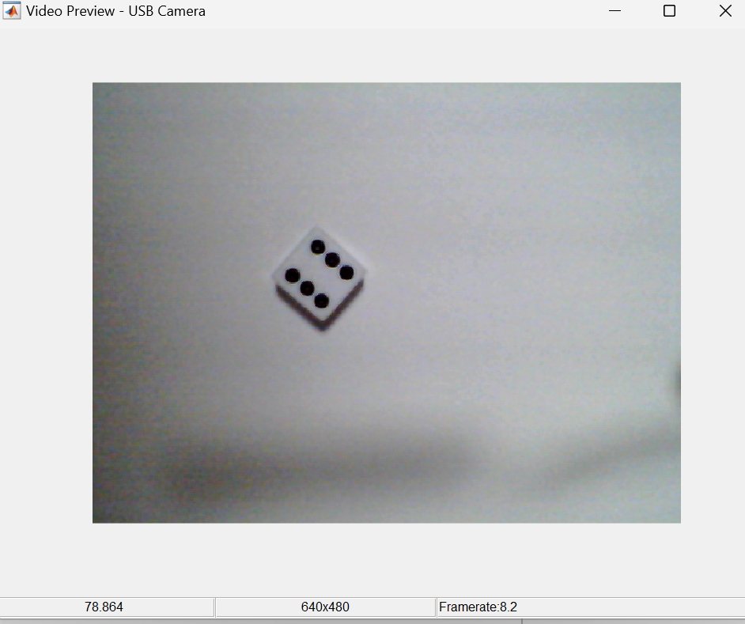
Synthesis – Modeling Part II
Synthesis – Modeling Part II
Initial image taken of dice on a plain white background, before cropping. White is the easiest color to work with here since it has the most contrast from black.

Slide 5
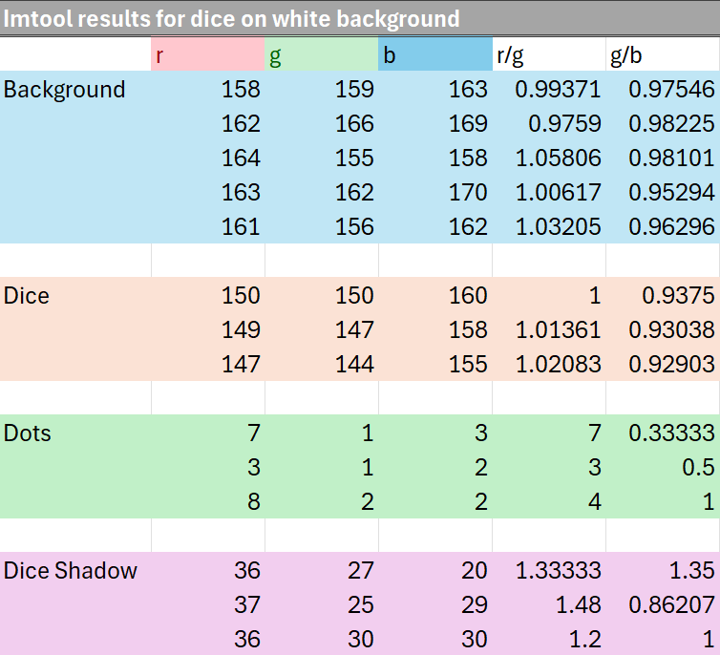
Synthesis – Modeling Part II
The spreadsheet created by inspecting the image for RGB values.

Slide 6
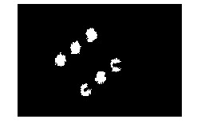
Synthesis – Modeling Part II
The final black and white processed, cropped image with one white blob for each dot on the dice face

Slide 7
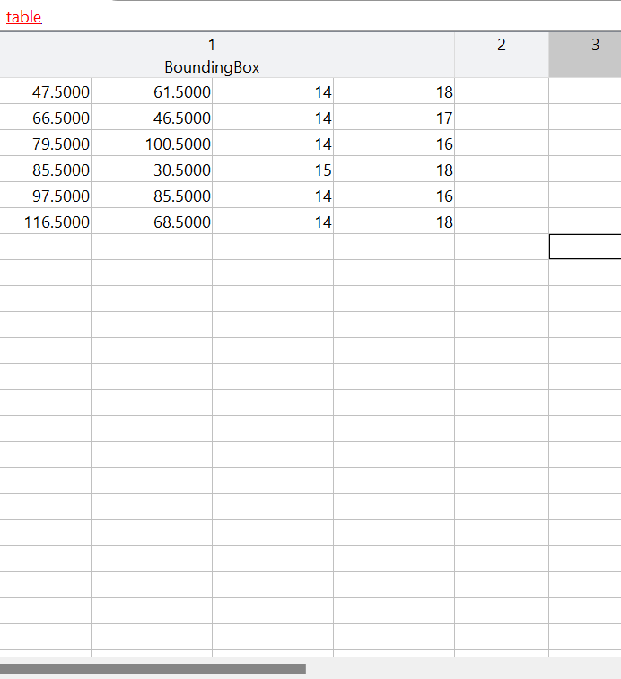
Synthesis – Modeling Part II
The bounding box for the processed image. 6 rows for 6 dots on the dice.

Slide 8
Evaluation 2 – Analysis from Modeling
Instructions
Evaluation 2 – Analysis from Model
You just completed your second model which should help you define what your "design space" is - it helps you put numerical limits on your design to make your first actual build or process more likely to succeed.
When you completed each model, there was a result - and after completing the second modeling activity there was an analysis hint.
In paragraph form, describe your ANALYSIS of those two results. The hints should help you focus your thought about what the results mean for your design
You can find the rubric for this section on the next slide.

Slide 9
Evaluation I – Analysis from Modeling
Rubric
Evaluation I – Analysis from Models
RUBRIC:
Each subsystem lead needs to answer the following questions for this section. The answers should be in complete sentences and address the questions specific to your section.
Points are awarded as follows: 2 points for clear writing, 8 points for each of the modeling results analysis content:
Game Structure: Does your design have a reasonable chance of functioning, and how are you handling stability and torque requirements?
Game Piece Mover: How are you implementing the results of your modeling into the vertical movement and the game piece/end effector designs?
Code: How does having a virtual game enhance your ability to design a game with better play dynamics?
Game Board: How are design factors accounted for in game board layout and what combination of dump and swap features will you design into your board and why?
Vision: What are some strategies you will use to reliably get the correct dice roll reported?

Slide 10
Evaluation 2 – Analysis from Modeling
Evaluation 2 – Analysis from Models
What are some strategies you will use to reliably get the correct dice roll reported?
From the previous assignment, I figured out that the dimensions of the dice tower need to be properly setup to ensure that not only the dice does not get stuck when tumbling down the shaft of the tower. On top of this, I also learned about the FOV of the camera and its distance from the board so that it is able to properly see the dice inside of the dice box.
The main strategy that I realized from this assignment was that the black dots on the dice have an abnormally high red/green ratio. I used this to my advantage and decided to use this ratio to pick out the black dots from the rest of the image. The red/green ratios for the majority of the image were around 1, while the red/green ratios of the dots on the dice varied anywhere from 3 all the way up to 7. Even when I took the shadow cast from the dice onto the white background into consideration, these values still worked perfectly for me since the red/green ratio of the shadow was only slightly higher than the background (around 1.2-1.5). I will be able to use this during the final build to reliably get the correct dice roll reported.

